Slide 1
Ministry/ Organization name:
ITC Limited
Problem Statement :
To build a computer simulation model for optimizing packaging design for a given packaged food.
Team Name :
CodeForVision
Team Leader Name :
Namandeep Singh
College Code :
1-3513111027
Problem
Packaging format for food products need to be designed based on a simulation model. This model should involve a multi body dynamics study to evaluate the maximum forces the final packaged food will be subject to during transit and handling. A simulation has to be done basis forces that products undergo during the journey in the supply chain.

Slide 2





Solution
Optimal solution for Food Packaging.
Technology Stack
A package provides protection, tampering resistance, and special physical, chemical, or biological needs.
A smart website will be generated which will specify the type such as primary, secondary and tertiary packaging format for the respective food sample.
Various tests such as shock, vibration, compression, temperature, bacteria, etc will be taken into account while generating the result.
After physical protection check, different barriers such as barrier from oxygen, water vapor, dust, etc will be applied if required.
For efficient handling, containment will be decided according to the type of product. Liquids, powders, and granular materials need containment.
According the recorded data, the algorithm will generate the optimal solution that can be used as packaging techniques for the food product.

Slide 3
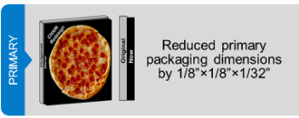

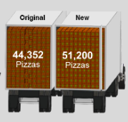
Example
Increase in 6,848 Pizza’s per Load.
8% Area Efficiency.
If one pizza costs around 100 than we can save upto 6.84 lakhs.

Slide 4
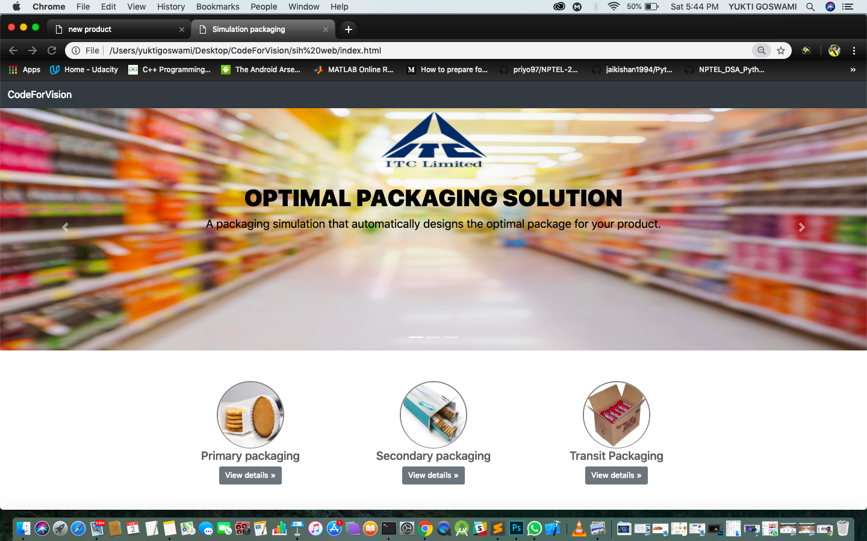
Screenshot
Optimal solution for Food Packaging.
Home Page

Slide 5
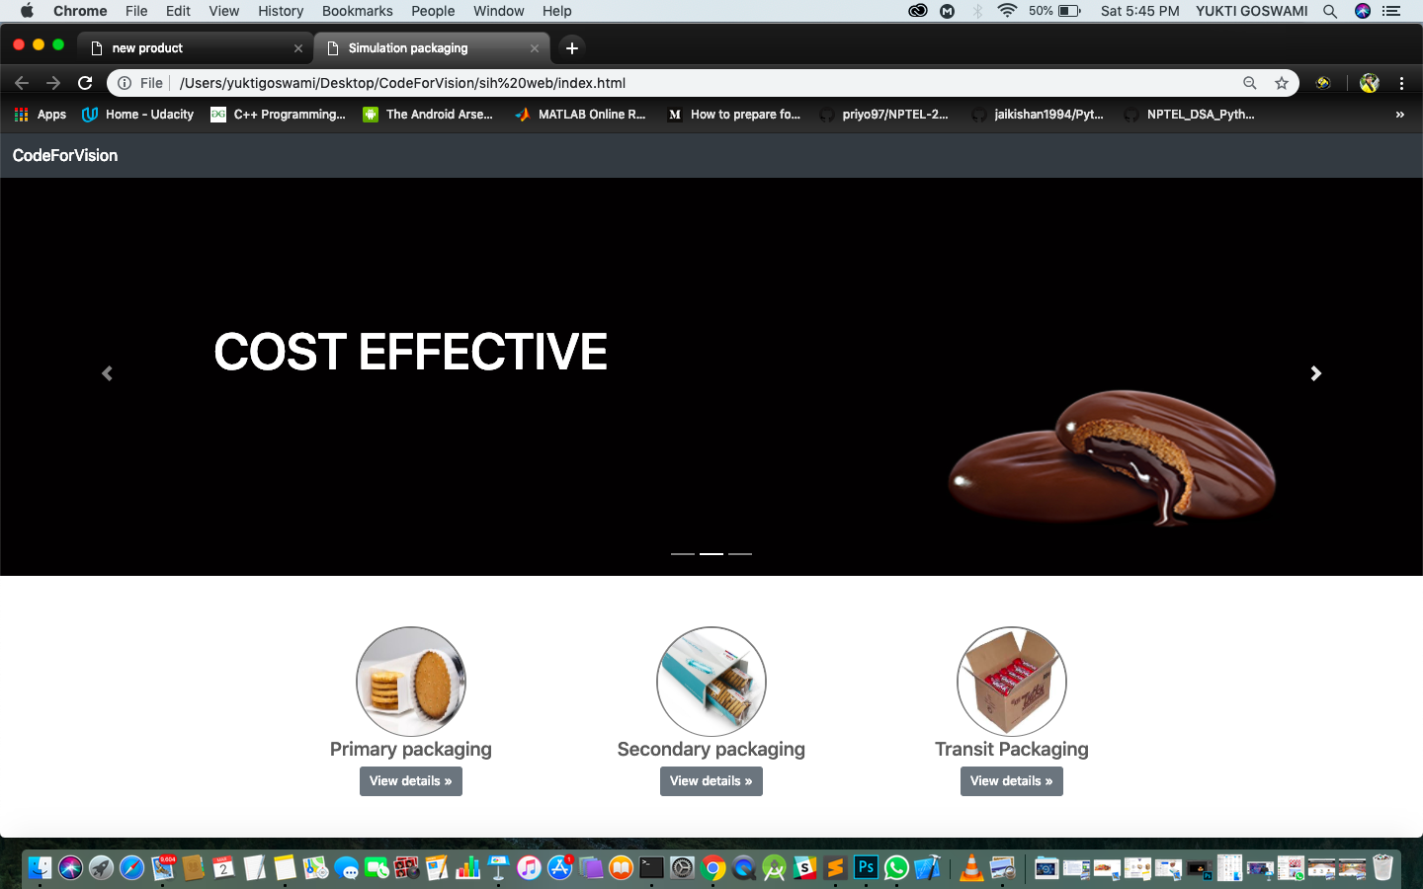
Screenshot
Optimal solution for Food Packaging.
Home Page

Slide 6
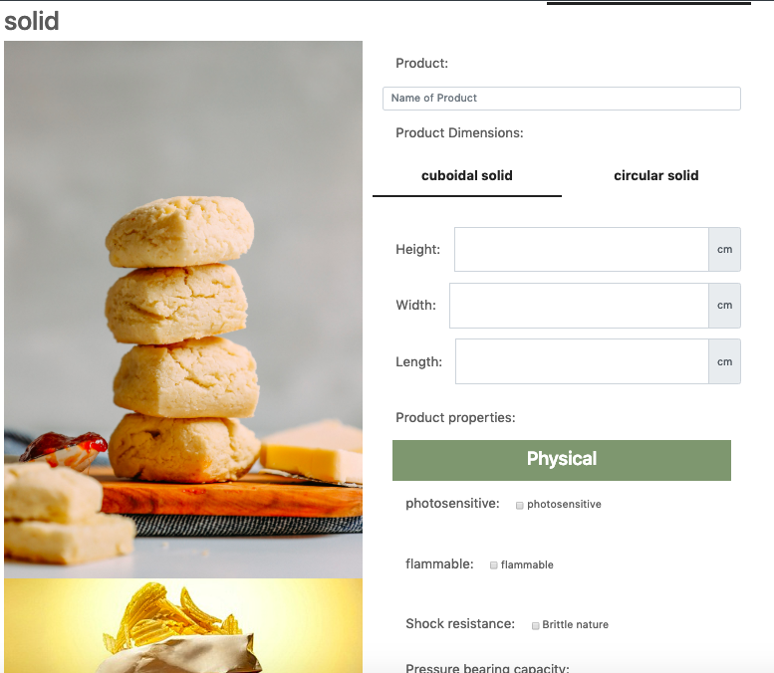
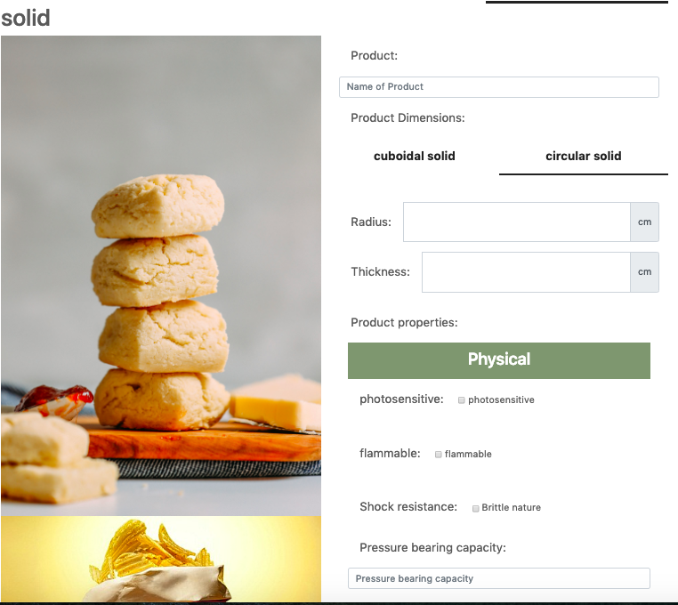
Screenshots
Optimal solution for Food Packaging.

Slide 7
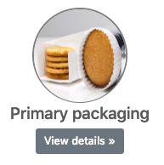

Data Flow Diagram
Selection
PRIMARY PACKAGING MATERIAL
Input
Form
Send
Result
For
Material
Packaging.py
Mapping
Data of material properties
Codebase.py

Slide 8
Factors
Orientation
Optimal solution for Food Packaging.
1
1
Example
2
1
2
Maximum Area
(Calculated from given dimensions)
4
1
2
4
24
Factors Calculated
6
1
2
3
6
L=4
8
1
2
4
8
W=3
H=2
12
1
2
3
4
6
12
Best Optimal Solution for 24 biscuits is 3 column 2 layer arrangement of biscuit stacks having total Surface Area = 348 units according to above taken dimensions.
24

Slide 9
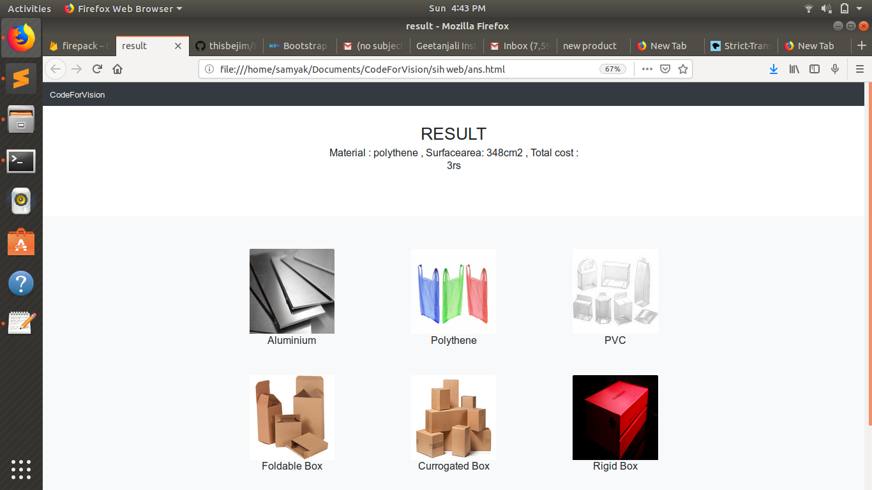
Screenshot
Optimal solution for Food Packaging.
Result Page

